Slide 1

HIT 333 Cyber Security Assignment 1
Alan Hubbard
S326012

Slide 2
Task 1 - ISM and PSPF
ISM – Australian Cyber Security Centre, Australian Signals Directorate
Principles and Guidelines
PSPF – Attorney General’s Department
Governance, Information, Personnel and Physical
Notes:
https://www.cyber.gov.au/acsc/view-all-content/ism
https://www.protectivesecurity.gov.au/policies

Slide 3
Organisational structure
CEO
COO
CFO
CIO
CTO
Security Advisors
Security Managers
Managers/Supervisors
Managers/Supervisors
Managers/Supervisors
Notes:
Focus on CTO and Security Advisors/Managers roles and responsibilities.
Chief Security Officer – provides strategic oversight and leadership to enable implementation of the security plan and its development.
Security Advisors – responsible for implementing and monitoring the security plan

Slide 4
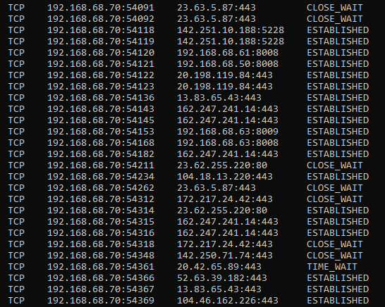
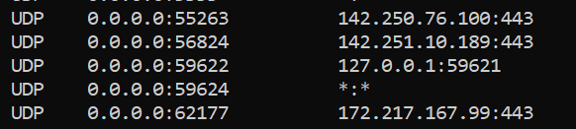
Task 2 – netstat -an
Notes:
Headers – Proto, Local and Foreign Address, State.
TCP/UDP
IPs
States
Ports

Slide 5

Task 3 – Option 3
Legality vs Ethics
Company position/policy
Advantage through insider knowledge
Legitimacy of tender process
Notes:
Situation: Charlie and Iris are working in the same company but a different department who meets during lunch time to discuss about their work. Today Iris discussed about a new position being created and Human Resources department starting advertising the position. Charlie then tells Iris “ I have a friend who runs a placement service and an find the right person. Once the position is filled, I will split the finder’s fee with you” .Iris knows that her company may pay as much as half a years’ salary for the placement services. Charlies’ friend is likely to pay him a substantial amount if Iris awards the placement contract to them. If she can get a good employee and a little extra money on the side, everyone wins.
However, Iris is not comfortable with such an arrangement, and she’s pretty sure it’s against company policy.If this comes to pass, is Charlie or Iris doing anything illegal? What’s ethically wrong with Charlie’s proposal?
Legality Vs Ethics
Company position
Corporate advantage
Honesty
Tender process
https://depositphotos.com/117587254/stock-photo-casual-people-meeting-at-cafe.html

Slide 6

Task 4 – Option 5
Risks of Personal Devices
Mitigation
Access to information
Types of Devices
Use of antimalware or antivirus software
Notes:
BYOD – creates security risks and vulnerabilities
Personal applications are unrestricted
Mitigations
Reduction of access to company/organisational files
Restriction of type of device used
Use of antimalware or antivirus software
Training
https://sepiocyber.com/wp-content/uploads/2020/03/BYOD-white-paper-1024x536.jpg

Slide 7

Training
Notes:
Training provides the greatest risk and defences against cyber/information vulnerability.
https://www.airswift.com/hubfs/employee%20training%20and%20development.png

